Slide 1







JUNE MONTH-2025
CLUB ACTIVITIES

Slide 2









LOVELY VOICES CLUB
CLASS I A & I B
DATE | NAME OF THE SONG | LEARNING OUTCOME
4/6/25 | Summer Song | To develop the talent of students in singing and to learn about summer season and new words related to summer through singing.
11/6/25 | Summer Song | To develop the talent of students in singing and to learn about summer season and new words related to summer through singing.
18/6/25 | Roll your hands song | Singing helps children to develop a good sense of rhythm and pitch, which are important for language development.

Slide 3

NATURE CLUB
CLASS II A & II B
DATE | NAME OF THE ACTIVITY | MATERIALS REQUIRED | LEARNING OUTCOME
4/6/25 | Leaf printing | Different kinds of leaves , Paint brush -1, Paint pallet -1, A4 sheet (5 Nos), Acrylic colours, (any 5 colours ) | To understand the importance and benefits of various kinds of leaves.
11/6/25 | Bird nest making | Dried twigs, Gum , Cardboard( 5 to 10cm round cardboard), Yarn - 1, String -1, Feathers pompoms, Dried leves | This activity is an easy way for students to explore and experiment with a variety of materials. The different colors and textures provide interesting sensory play along with promoting the use of fine motor skills.
18/6/25 | Nature crown and wand | Jute rope (1 mtr), Double side tape, Ribbon (mtr –2 inch any colour ), Fresh leaves, Fresh flowers, Medium size thin branch (1), Yarn (1 any colour) | This activity is great for practising fine motor skills and fun to use in pretend play.

Slide 4





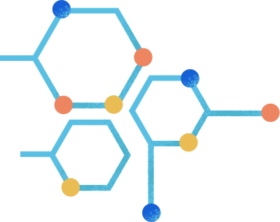
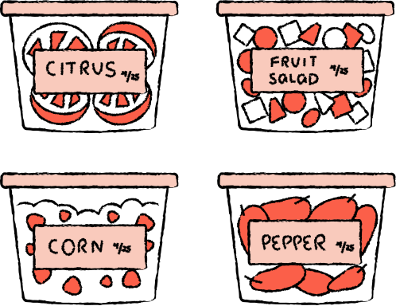
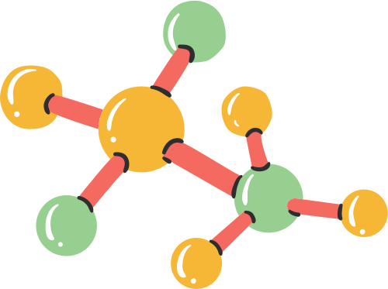
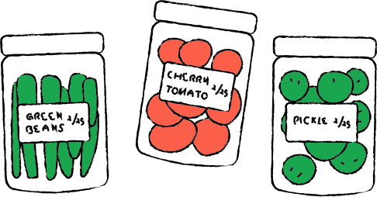

HOME SCIENCE CLUB
CLASS III A
DATE | NAME OF THE ACTIVITY | LEARNING OUTCOME
19/06/25 | Food preservation method | Understand how to extend the shelf life of food and prevent spoilage while maintaining its nutritional value and safety.

Slide 5

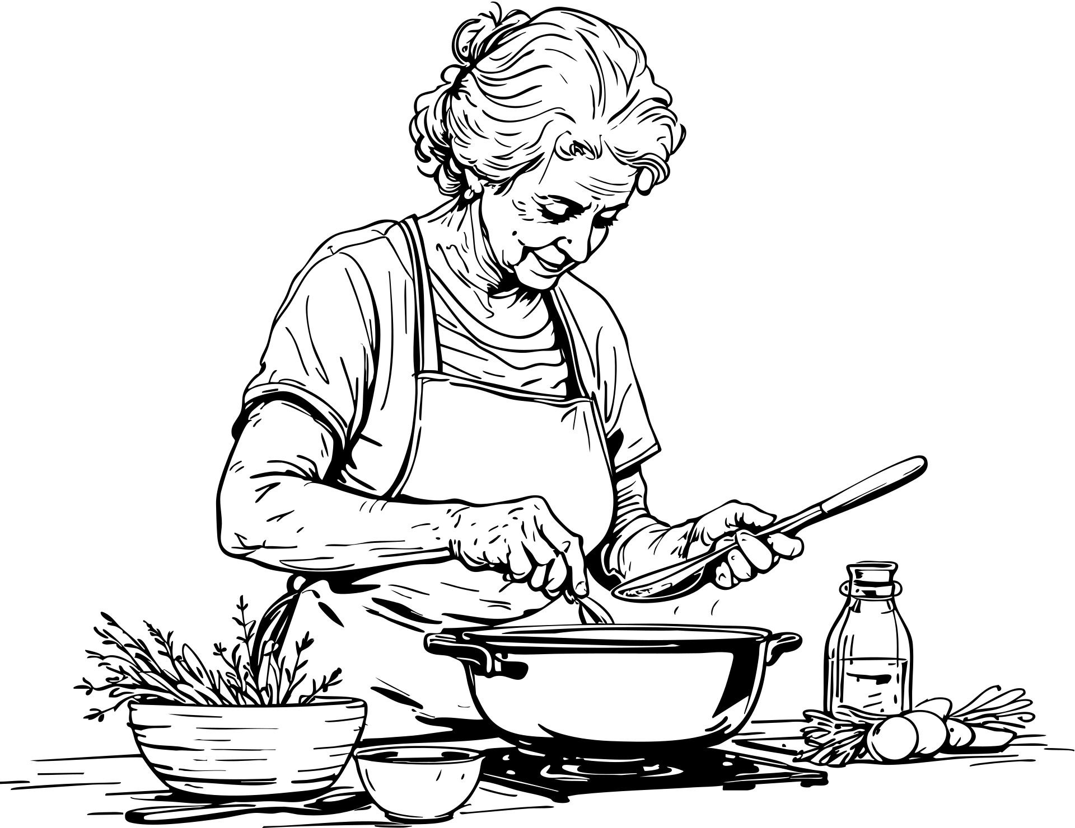
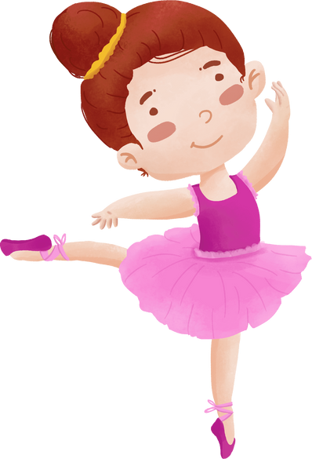


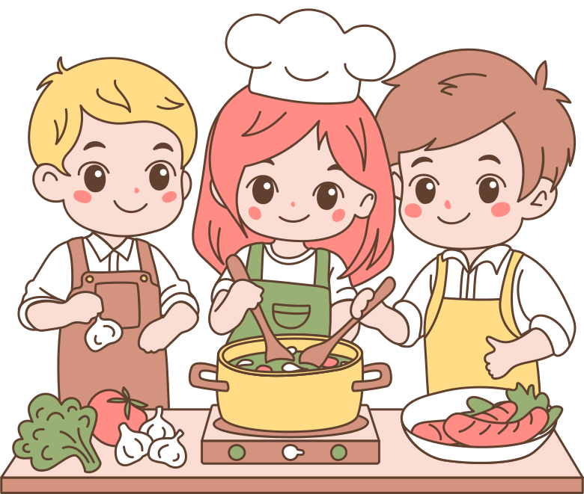


HOBBY CLUB
CLASS III B
DATE | NAME OF THE SONG | LEARNING OUTCOME
19/06/25 | Fireless cooking | To understand the nutrient value of fruits and vegetables and their taste. Learning to eat and enjoy making healthy snacks and encourages students to develop healthy eating habits.

Slide 6


HERITAGE CLUB
CLASS IV A & IV B
DATE | NAME OF THE ACTIVITY | LEARNING OUTCOME
13/06/25 | Heritage symbols used as official seal of India /Indian states / other countries | To understand that these symbols are intrinsic to the Indian identity and heritage. To promote the practice of science and other cultural activities.
20/06/25 | Heritage sites of South India | Children will be able to evoke surprise and admiration by creating accessibility to their work, products, and minds.

Slide 7








CREATIVE CLUB
CLASS IV C
DATE | NAME OF THE ACTIVITY | LEARNING OUTCOME
13/06/25 | Hand Puppet | The fine movement required to wear a puppet helps with dexterity and using fingers to manipulate the puppet improves fine motor coordination.
20/06/25 | Gift Box | To improve the listening skill of the students.

Slide 8





KARUNA CLUB
CLASS V A & V B
DATE | NAME OF THE ACTIVITY | LEARNING OUTCOME
17/06/25 | Karuna club inauguration | To awake in children the inherent love, kindness, and compassion towards all living beings, plants, animals, fellow human beings and our environment.
Let’s Save Our Earth!

Slide 9













SCIENCE CLUB
CLASS VI A
DATE | NAME OF THE ACTIVITY | LEARNING OUTCOME
4/06/25 | Reduce E- waste- Awareness session | Students learn about the benefits of responsible recycling
11/06/25 | Reduce E- waste- Waste Segregation | Implementing a waste segregation system within classrooms with separate bins for dry and wet waste instils good waste disposal habits among students.
18/06/25 | Adopt Sustainable Food Systems | It promotes healthy eating habits and practical learning about agriculture, nutrition and sustainability.

Slide 10



SOCIAL AWARENESS CLUB
CLASS VI B & VI C
DATE | NAME OF THE ACTIVITY | LEARNING OUTCOME
4/6/25 | HEALTH AWARENESS & POSTER MAKING | By raising public awareness about important health issues, healthcare campaigns can reduce ill health and premature deaths from diseases that are treatable if they are addressed in time.
11/6/25 | BMI CHECKING. | By Knowing what affects their BMI and how to calculate it is an important tool for helping students understand their own health.
18/6/25 | TO CREATE HEALTH AWARENESS AMONGST SUPPORT STAFF | Knowledge about the human body, common medical conditions, healthy lifestyle practices, and preventive measures to maintain overall well-being.

Slide 11




Disaster MANAGEMENT CLUB
CLASS VII A
DATE | NAME OF THE ACTIVITY | LEARNING OUTCOME
4/6/25 | Disaster Management Cycle | Students attain a more profound comprehension of the Pre-Disaster, Disaster Occurrence, and Post- Disaster phases.
11/6/25 | Collage of Multidisciplinary disaster management team | Students are capable of identifying the professionals engaged in a multidisciplinary management team and may approach them, if necessary, in real-time scenarios.
18/6/25 | Triage | Students will acquire the knowledge on Triage which acts as a foundation for further proceedings of the injured.

Slide 12








SPORTS CLUB
CLASS VII B & VII C
DATE | NAME OF THE ACTIVITY | LEARNING OUTCOME
4/6/25 | Introduction of under arm passing in volley ball | To promote knowledge, understanding and appreciation to the game of volleyball . To develop self discipline and teamwork during training and actual games.
11/6/25 | Tossing and Passing | To develop satisfactory competency in basic skills such as body, posture, forearm pass.
18/6/25 | Bouncing and passing | To promote knowledge, understanding and appreciation to the game of volleyball . To develop self discipline and teamwork during training and actual games. To develop satisfactory competency in basic skills such as body, posture, forearm pass.

Slide 13



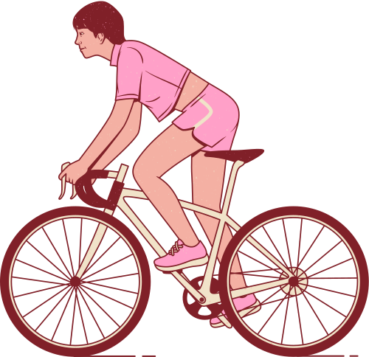
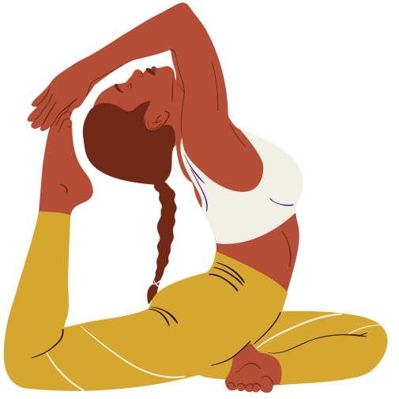
HEALTH & WELLNESS CLUB
CLASS VIII A
DATE | NAME OF THE ACTIVITY | LEARNING OUTCOME
4/6/25 | Fitness Exercise | Fitness exercise encompasses a variety of physical activities designed to improve overall health, strength, flexibility, and endurance.
11/6/25 | Fireless cooking (Group Activity) | Healthy snacks for children are not just about fulfilling their nutritional requirements but also about encouraging good eating habits from an early age
18/6/25 | Making of Food Pyramid (Individual activity) | Students can list the five food groups that make up the food pyramid.

Slide 14





LITERARY CLUB
CLASS VIII B & VIII C
DATE | NAME OF THE ACTIVITY | LEARNING OUTCOME
4/6/25 | Book Title Pictionary | Improves comprehending vocabulary Improves drawing skill while interpreting titles through diagrams ,Widens the knowledge about books
11/6/25 | Guess the Idiom | Improves knowledge about idioms and communication skills, Learns the appropriate use of idioms
18/6/25 | The Book Blurb Game | Enables to comprehend Inculcate and kindle curiosity to read the book, Enable to make students voracious readers.

Slide 15
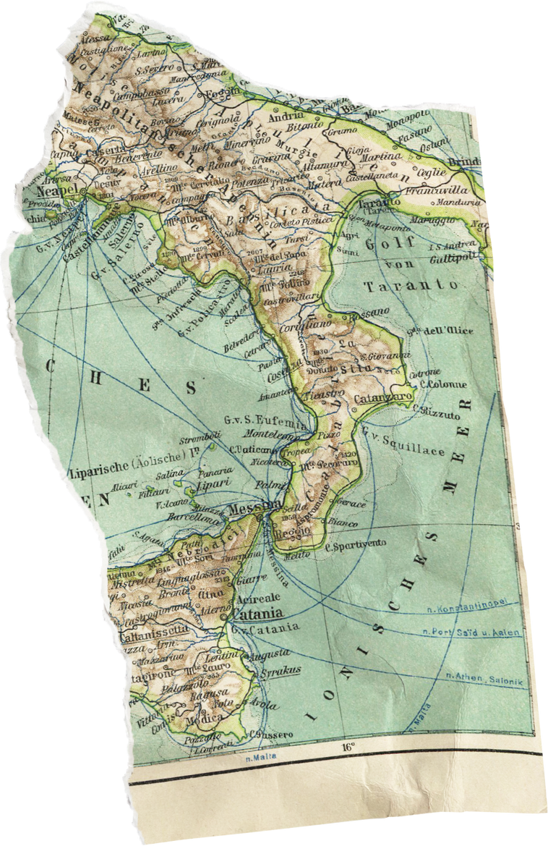







YUVA Tourism
CLASS IX A & IX B
DATE | NAME OF THE ACTIVITY | LEARNING OUTCOME
4/6/25 | FORMING CLUB MEMBERS | To allocate an exclusive notice board or channel of information for Tourism Club activities.
11/6/25 | LOGO DESIGNING | To create interest among students. logo-designing competition will be conducted.
18/6/25 | SEMINAR | To motivate the students to explore more about the Ministry of Tourism and its functions and activities.

Slide 16



PHILATELY CLUB
OPTIONAL (CLASS VI TO X)
DATE | NAME OF THE ACTIVITY | LEARNING OUTCOME
4/6/25 | Explanation about collection of stamps | Children learn various modes of collecting/gathering the stamps
11/6/25 | Stamps on Presidents(India) | Through attached link children will be able to learn various types of stamp
18/6/25 | Visit by Philatalist

Slide 17








IIMUN CLUB
OPTIONAL (CLASS VI TO X)
DATE | NAME OF THE ACTIVITY | LEARNING OUTCOME
4/6/25 | Nomination for club president | Students will be able to describe the scope and responsibilities of different leadership roles within the club members and demonstrate an understanding of how these roles contribute to the effective functioning of the team.
11/6/25 | Election of club president and declaration of result | Learn about the different safety measures and to apply in real life scenario if any.
18/6/25 | 25 Indian values “My “Role as a Youth In Bharat” | Students will understand the democratic process of electing a club president, participate respectfully in the election procedure, and recognize the importance of leadership, fair voting, and student representation in the IIMUN Club

Slide 18






VOLUNTEERING CLUB
OPTIONAL (CLASS VI TO X)
DATE | NAME OF THE ACTIVITY | LEARNING OUTCOME
4/6/25 | TREE PLANTATION IN SCHOOL | Learners will be able to reflect on “Tree Plantation”.
11/6/25 | LIFE ON LAND | Learners will be able to write slogans and design posters incorporating the discussions made in class.
18/6/25 | SWACHH BHARA ABHIYAN | Learners will be able to spread awareness among public – to encourage public participation and community involvement.

Slide 19


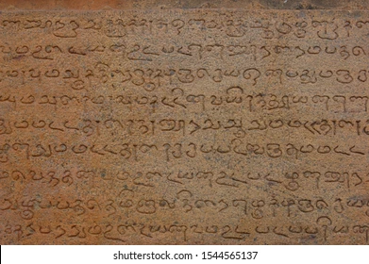



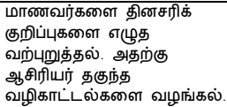
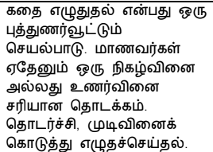



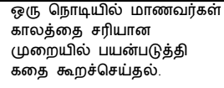
OPTIONAL (CLASS VI TO X)
DATE | NAME OF THE ACTIVITY | LEARNING OUTCOME
4/6/25
11/6/25
18/6/25

